Slide 1
Gunpowder River Woody Debris
York Rd to Big Falls Rd
Distance ≈ 2.6mi. (4.0 km)
March 16, 2011

Slide 2
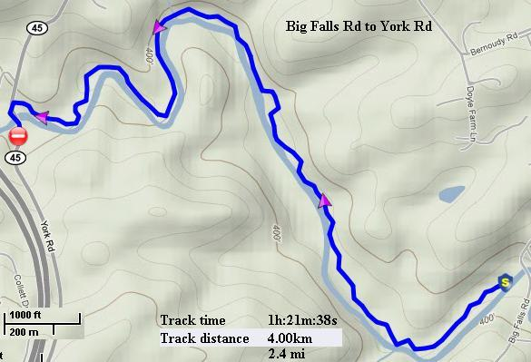
Continuous photo inventory of woody debris
GPS recorded route

Slide 3
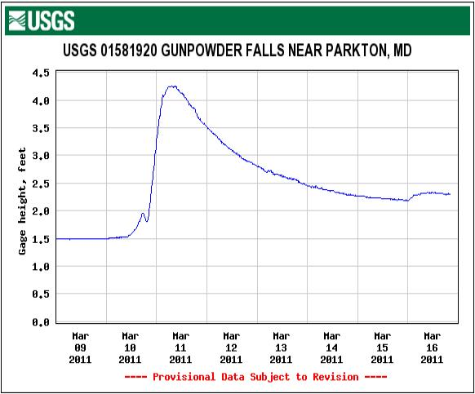
Flow

Slide 4
Station 1 Start

Slide 5
Station 2
This limbo log is easily and safely navigated at most levels.

Slide 6
Station 3a

Slide 7
Station 3b
Passable at current and lower levels.

Slide 8
Station 3c

Slide 9
Station 4
Someday this may pose a hazard.

Slide 10
Station 4b
No crown to prevent creation of a dam.

Slide 11
Station 4c
If this future strainer collects enough debris it may cause erosion on the left bank. The area already floods.

Slide 12
Station 5a
This debris has been several years clearing. I has also been the source of a lot of fun and trouble. High banks preclude an easy a portage.

Slide 13
Station 5b

Slide 14
Station 6
No Problems here for experienced paddlers.

Slide 15
Station 7

Slide 16
Station 8
No problems here, yet.

Slide 17
Station 9

Slide 18
Station 10

Slide 19
Station 11

Slide 20
Station 12a
River-wide Strainer

Slide 21
Station 12b

Slide 22
Station 12c
Easy portage river right.
Notes:
Low density wood, rots quickly.

Slide 23
Station 12d

Slide 24
Station 13

Slide 25
Station 14
Erosion is eating away at the North Trail.

Slide 26
Station 15a

Slide 27
Station 15b

Slide 28
Station 15c
Often debris collects here .

Slide 29
Station 16
Limbo log.

Slide 30
Station 17

Slide 31
Station 18

Slide 32
Station 19
Though shallow on river right, the bottom is soft making a portage tricky.

Slide 33
Station 20
River right route at all levels.

Slide 34
Station 21
Bump and grind over at this level but lower levels requires a portage.

Slide 35
Station 22

Slide 36
Station 23

Slide 37
Station 24

Slide 38
Station 24b
Easy portage on river right..

Slide 39
Station 25

Slide 40
Station 26
Notes:
Understory trees: dogwood, hornbeam, spicebush

Slide 41
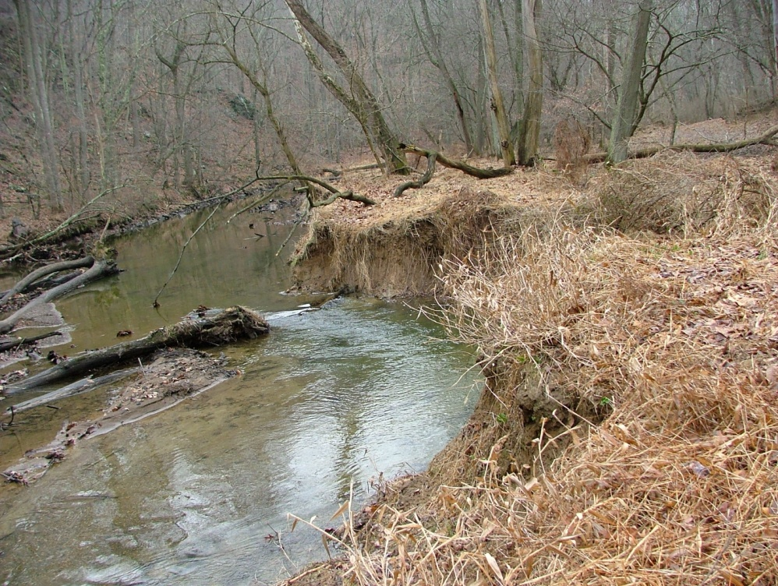
Station 27a previously
How did not addressing this improve the habitat?
Notes:
The log/strainer that caused this erosion was present for approximately 3 years. The original sneak route was on river right. The route was narrow and complicated passage. While an enjoyable challenge for experienced paddlers it presented a danger to the inexperienced. Prior to natural moving the strainer, the bed was bowled by current moving under the log. This did create great place for fish to wait for food. For fishermen the danger was slipping into the bowl and becoming entrapped under the log. The tree seen is not the original.

Slide 42
Station 27b currently

Slide 43
Station 27c currently

Slide 44
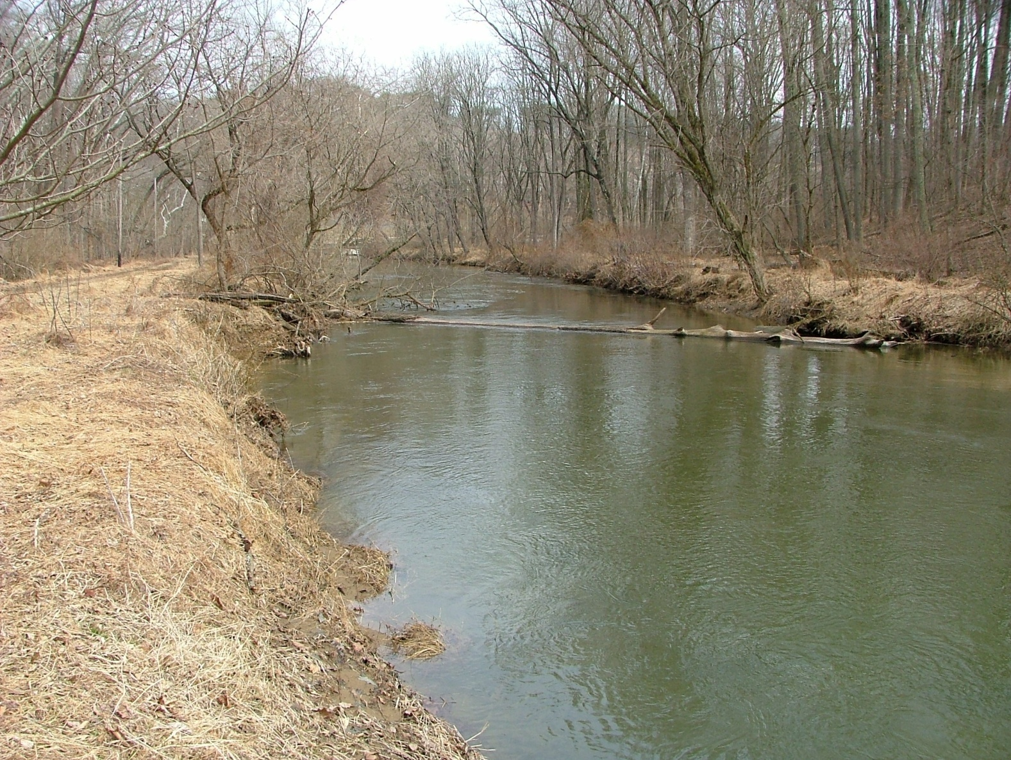
Station 28a

Slide 45
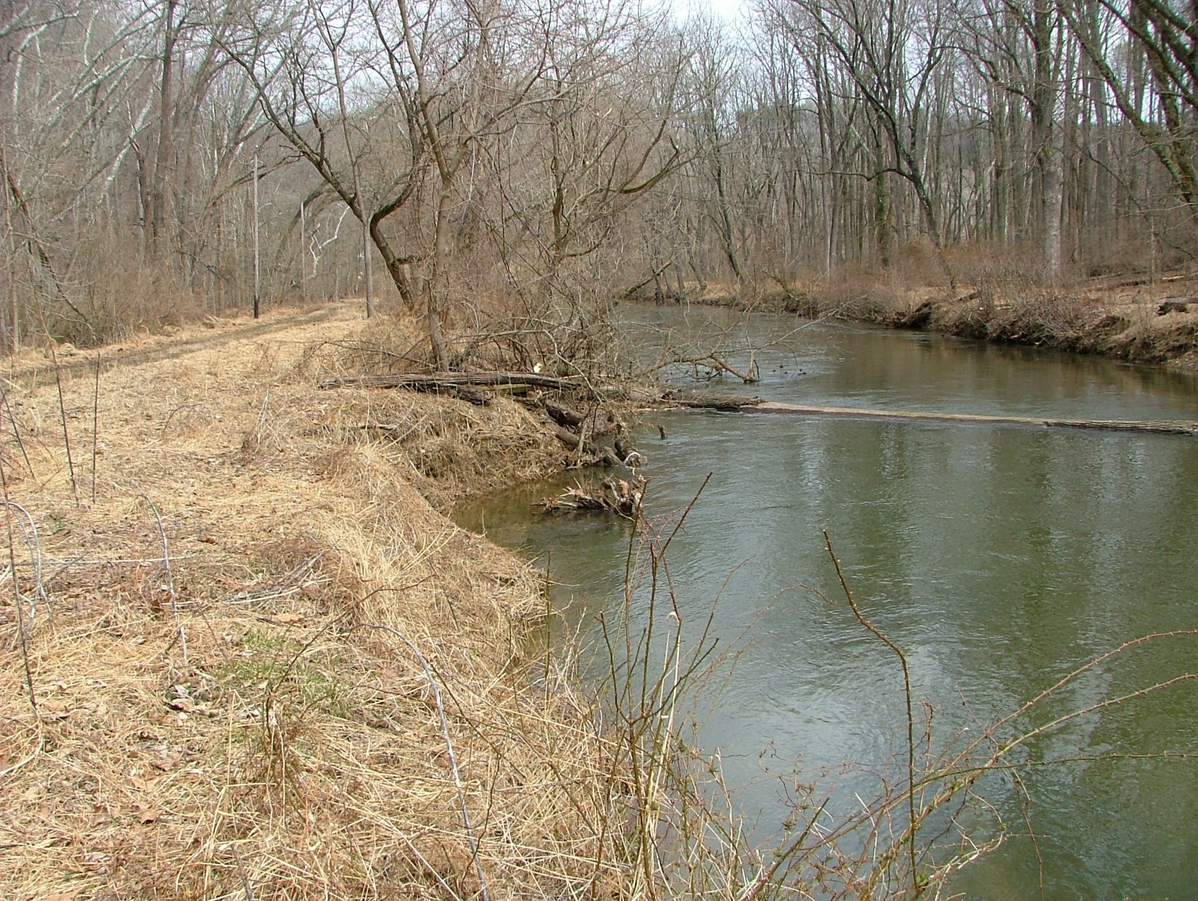
Station 28b
If this log causes as much erosion of the earlier example, the park road may be damaged.

Slide 46
Station28c
Erosion has already started to attack the bank.

Slide 47
Contact Information
Charles Hihn
18426 Gunpowder Rd
Hampstead, MD 21074
buddyh@hiventures.com
410-374-4164

